Slide 1



Presentation IV
Integrating Sphere
Thu Ta Zaw
2415121095

Slide 2

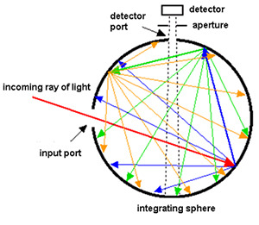
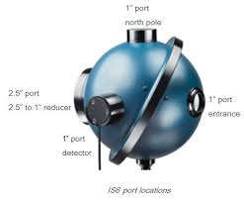
Integrating Sphere
Background
Integrating sphere is an optical measurement tool used to quantify how light interacts with scattering and absorbing media.
It is a hollow spherical cavity, coated internally with a diffuse reflective material.
Working principle
The radiation introduced into an integrating sphere strikes the reflective walls and undergoes multiple diffuse reflections.
After numerous reflections, the radiation is dispersed highly at the sphere walls.
The resulting integrated radiation level is directly proportional to the initial radiation level and may be easily measured by using a detector.
Fig. Detection of light reflection using integrating sphere
Fig. Ophir’s general-purpose sphere

Slide 3
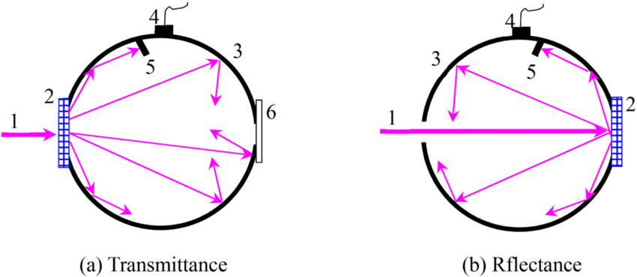
Measuring Scattering and Collimated Beam
(a)
(b)
Fig. (a) scattering beam inside integrating sphere and, (b) collimated beam inside integrating sphere
Scattering Beam
Scattering beam is a light beam that becomes diffused and broadened as photons interact with the medium.
Scattering beam describes how light deviates from its original path due to microscopic inhomogeneities in biological tissues.
Beam scattering is essential for measuring tissues optical properties (μₐ, μs′, g).
Collimated Beam
A collimated beam is a light beam whose rays are nearly parallel, producing minimal divergence, which allows the beam to propagate long distances without significant spreading.
It provides a controlled entry angle and uniform intensity, enabling accurate measurement of absorption, scattering, and transmittance in skin or tissue phantoms.

Slide 4
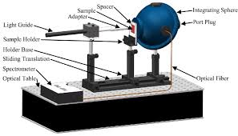

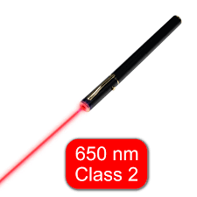
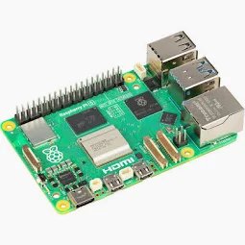
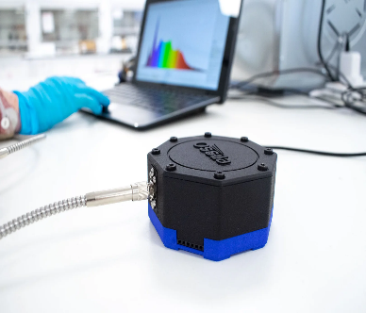
Integrating Sphere
Fig. Integrating sphere setup to measure the optical properties of sample
Fig. Optical properties measurement system setup
System Setup
Optical properties of samples measurement system include Integrating sphere, light source, Spectrometer, Raspberry Pi and monitor.
Raspberry pi will be used to control the laser pulse and, to receive the data from spectrometer and show on monitor.
The integrating sphere is firmly positioned along with the sample and light source.

Slide 5
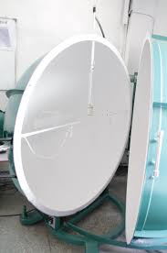
Reflective material
Use compound with high reflectance over 0.95.
To provide high diffuse reflectance inside integrating spheres ensuring uniform light distribution.
To reduces measurement errors caused by specular reflection, beam angle bias, and surface irregularities.
To maintain consistent optical calibration across the visible-NIR range (400- 1700 nm).
Typical material used include Spectralon (PRFE), with reflectance around 0.99 and BaSO₄, with reflectance around 0.96 to 0.98).
Fig. Inner reflective coating of integrating sphere

Slide 6

Integrating Sphere Setup
Light Source
To provide stable controlled illumination for optical property measurements, as spectral bandwidth and stability directly affect accuracy of μₐ and μs′ extraction.
Mostly used laser with wavelength range of 400-1700 nm to cover hemoglobin, melanin, water and lipid absorption bands.
Optical Spectrometer
To converts light intensity vs wavelength into quantitative data for extracting optical coefficient (μₐ and μs′).
Need to use low-noise spectrometer to ensure precise reflectance and transmittance calculations.
Mostly used spectrometer with the wavelength detection range of 400-1700 nm (VIS-NIR).
Fig. Class 2 laser with wavelength of 650 nm (VIS)
Fig. Ossila optical spectrometer

Slide 7
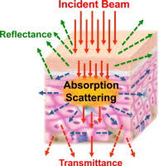
Optical properties of samples (skins and phantom )
The flowing data biomedical samples can be measured using the integrating spheres:
Diffuse reflectance Rd, which is a fraction of light diffusely reflected from sample.
Total transmittance Tt, which is a fraction of light transmitted (diffuse and direct).
Specular reflectance Rs, which is a mirror-like surface reflection.
Absorptance, which is a fraction of light absorbed by sample.
The flowing optical properties can be calculated from the measured data:
Absorption coefficient μa​, which describes the photon loss due to chromophore absorption.
Reduced scattering μs′​, which describes diffusion strength of scattered light.
Anisotropy Factor g, which describes the directionality of scattering (0 = isotropic and 1 = forward).
Refractive index n, which describes the boundary reflection and transmission.
Albedo a′, which describes the ratio of scattering to total extinction.
Penetration depth δ, which describes the effective photon travel depth.
Fig. Transmittance, Reflectance and absorption scattering of skin

Slide 8
The End
THANK YOU FOR LISTENING
Thu Ta Zaw
2415121095

